Slide 1
Remote Controlled Car with Autonomous Abilities
Group: BitterSweet
Michael Pruss 101008219
Michael Skalecki 100969837
Keyan Cassis 101011524
Zubaer Ahmed 101001925

Slide 2
Overview
Driving is a crucial part of everyday life and the development of safe and reliable assisted driving systems is paramount.
Project purpose: to develop a remote control vehicle with assisted driving abilities.
This presentation will discuss:
Advanced Driver-Assistance Systems (ADAS)
Project Deliverables
Vehicle Design and Components
Test Track and Testing
Project Scheduling and Work Breakdown

Slide 3
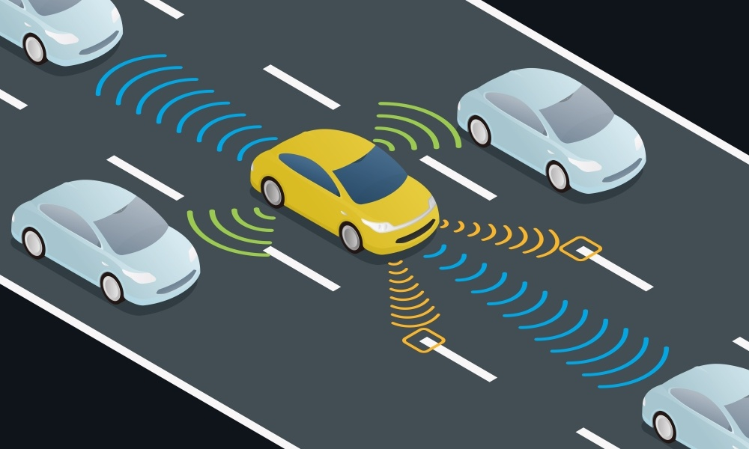
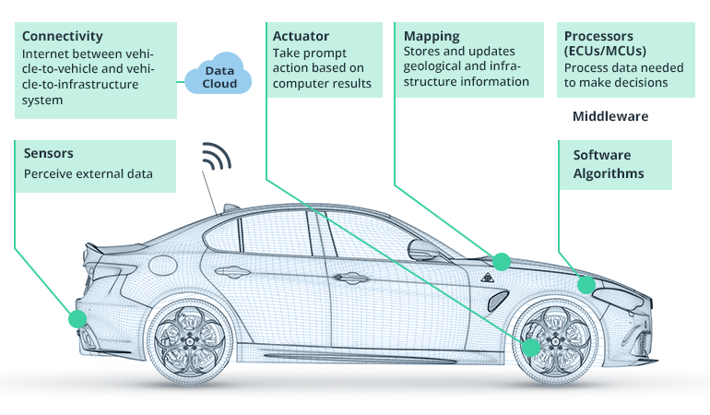
Introduction
Advanced Driver-Assistance Systems (ADAS) provides assistance to drivers by detecting and avoiding obstacles on the road.
Goal: Develop ADAS system that will avoid obstacles and prevent vehicle from moving outside of course boundaries.
Level 2 autonomous driving will be implemented.
User will remote control the vehicle while ADAS runs in the background.
Figure 1: Sensing the Environment [1]
Figure 2: ADAS Vehicle Components [2]

Slide 4
Deliverables and Requirements
Remote Control Deliverables:
The user shall be able to control the vehicle through a wireless remote control.
The user shall be able to control the vehicle in four directions; forward, backwards, right, and left.
The user shall be able to turn on and shutdown the vehicle’s motors.
The user shall be able to turn on and off the Autonomous Driving systems.
Autonomous Driving Deliverables:
The vehicle shall autonomously not pass the black line limits that denote the course.
The vehicle shall autonomously avoid collisions with any obstacles that are in the path of the vehicle.
The Autonomous Driving system shall override user remote control when the vehicle is about to collide with an obstacle or when the vehicle is about to pass over the black line limits.

Slide 5
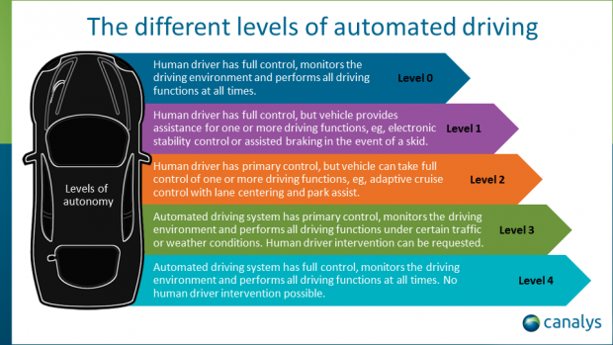
Advanced Driver-Assistance Systems (ADAS) Explanation
ADAS is used to assist drivers in driving by detecting and avoiding collisions.
ADAS uses sensors to survey and understand the environment.
Algorithms take surrounding environment into account when planning routes and collision avoidance.
ADAS level 2 autonomous driving takes control of steering and acceleration of vehicle from user when a collision may occur.
Figure 3: Autonomous Driving Levels [3]

Slide 6
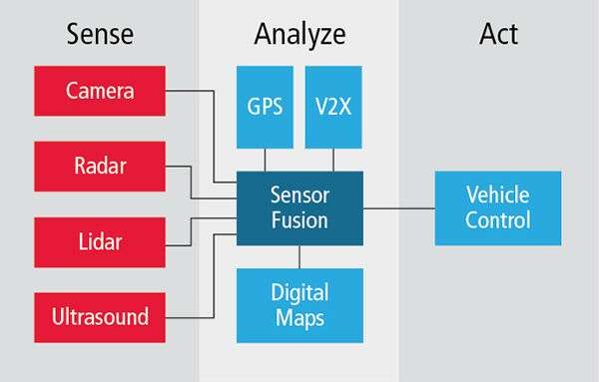
ADAS (cont)
Primary goal of ADAS is to gain sense of the environment to make better driving decisions for the vehicle.
Our project will include:
Obstacle avoidance.
Line detection and enforcement of staying within course borders.
ADAS will sense, analyze, and act based on the environment.
Figure 4: ADAS Individual Components [4]
Notes:
Talk about poll driven

Slide 7
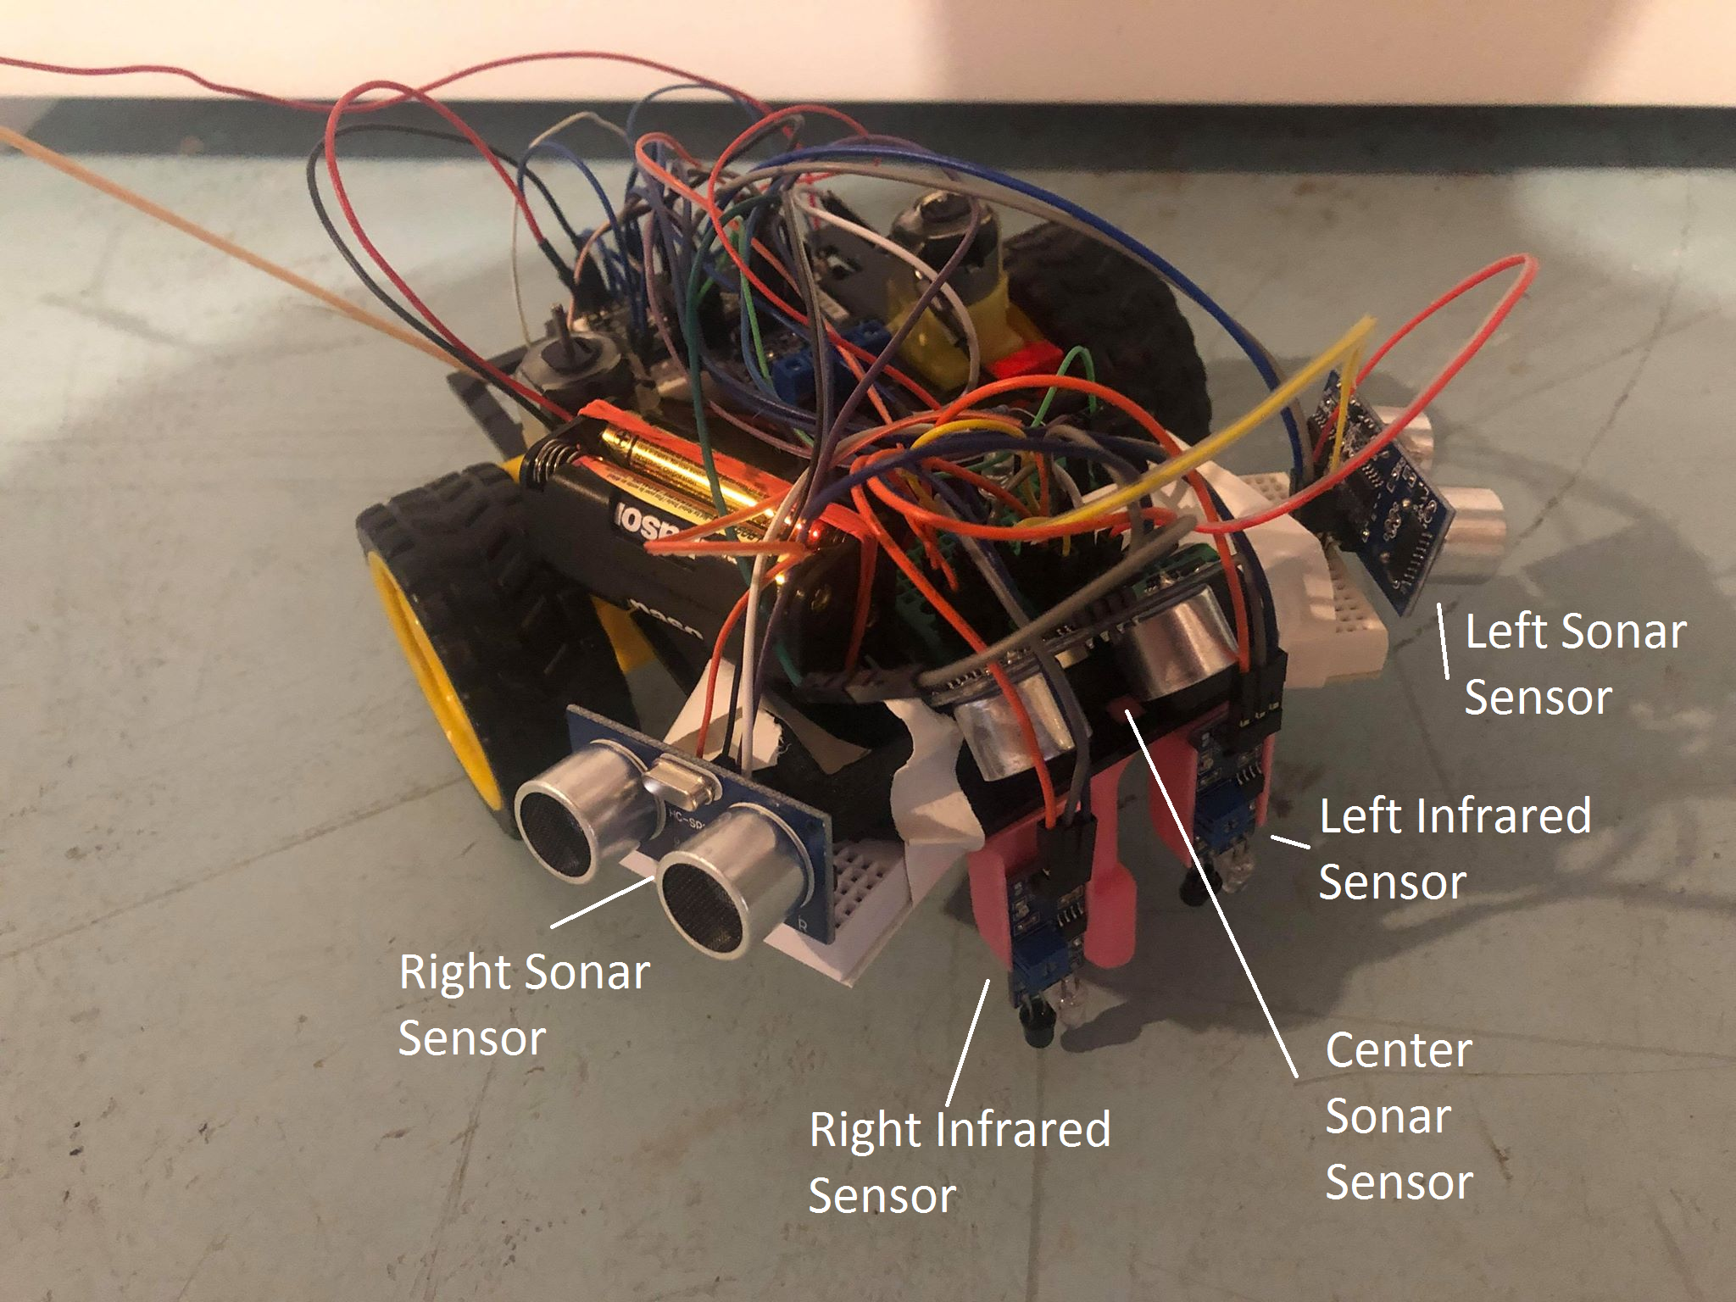
Vehicle Design and Sensors
Notes:
Sensor Fusion, stereo detection

Slide 8
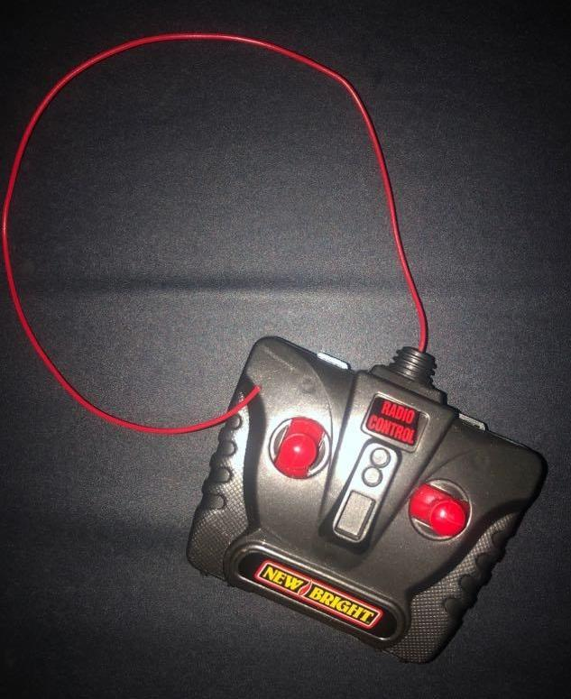
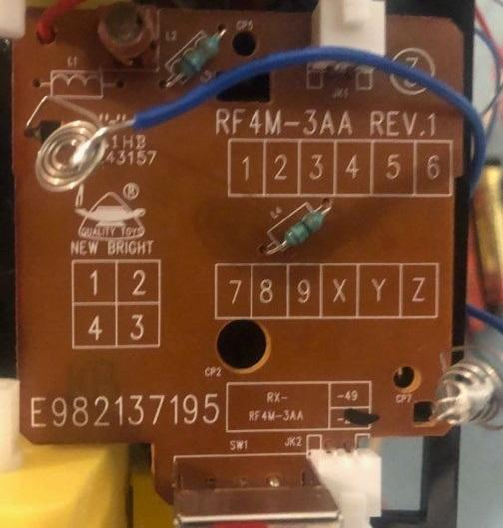
Remote Control Specifications
Transmitter is a controller from a third party RC car.
Receiver was taken from the RC car and connected to the Arduino.
RC operates over 49.86 MHz
Button presses will register 0 V and > 0 V based on user inputs

Slide 9
Vehicle Sensor and Hardware Requirements
The car is equipped with various peripherals to meet the project requirements of movement, steering, object detection, and ADAS functionality. These peripherals are connected to the car’s Arduino Nano microcontroller which reads the sensory data and outputs the correct response. The peripherals used on the car are:
Inputs
3 sonar sensors (left, center, right)
2 infrared sensors (left, right)
1 car switch push button
4 batteries for external power supply (6V)
2 analog sticks for car steering
Outputs:
1 H Bridge motor driver
2 DC motors
1 car light LED

Slide 10
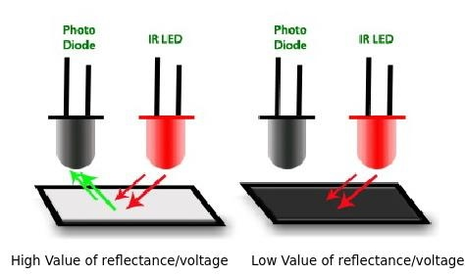
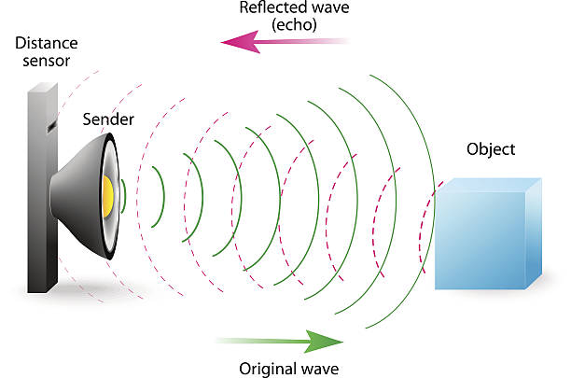
Sensor and Hardware Requirements (cont)
Figure 5: Infrared detection [5]
Figure 6: Sonar detection [6]

Slide 11
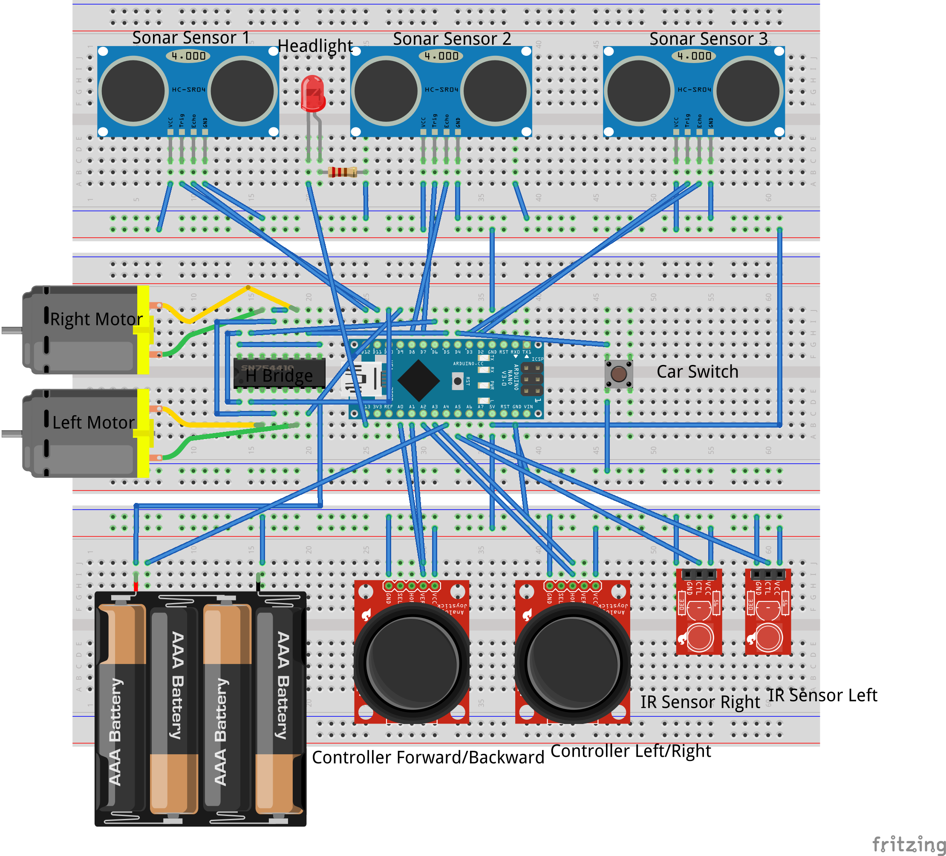
Circuit Diagram
The car’s circuit diagram shows all the peripherals connected the car’s microcontroller as well as what pins they are wired to.
3 sonar sensors (left, center, right)
2 infrared sensors (left, right)
1 H Bridge motor driver
2 DC motors
1 car switch push button
2 analog sticks for car steering
1 car light LED
4 batteries for external power supply
Notes:
Explain Analog sticks

Slide 12
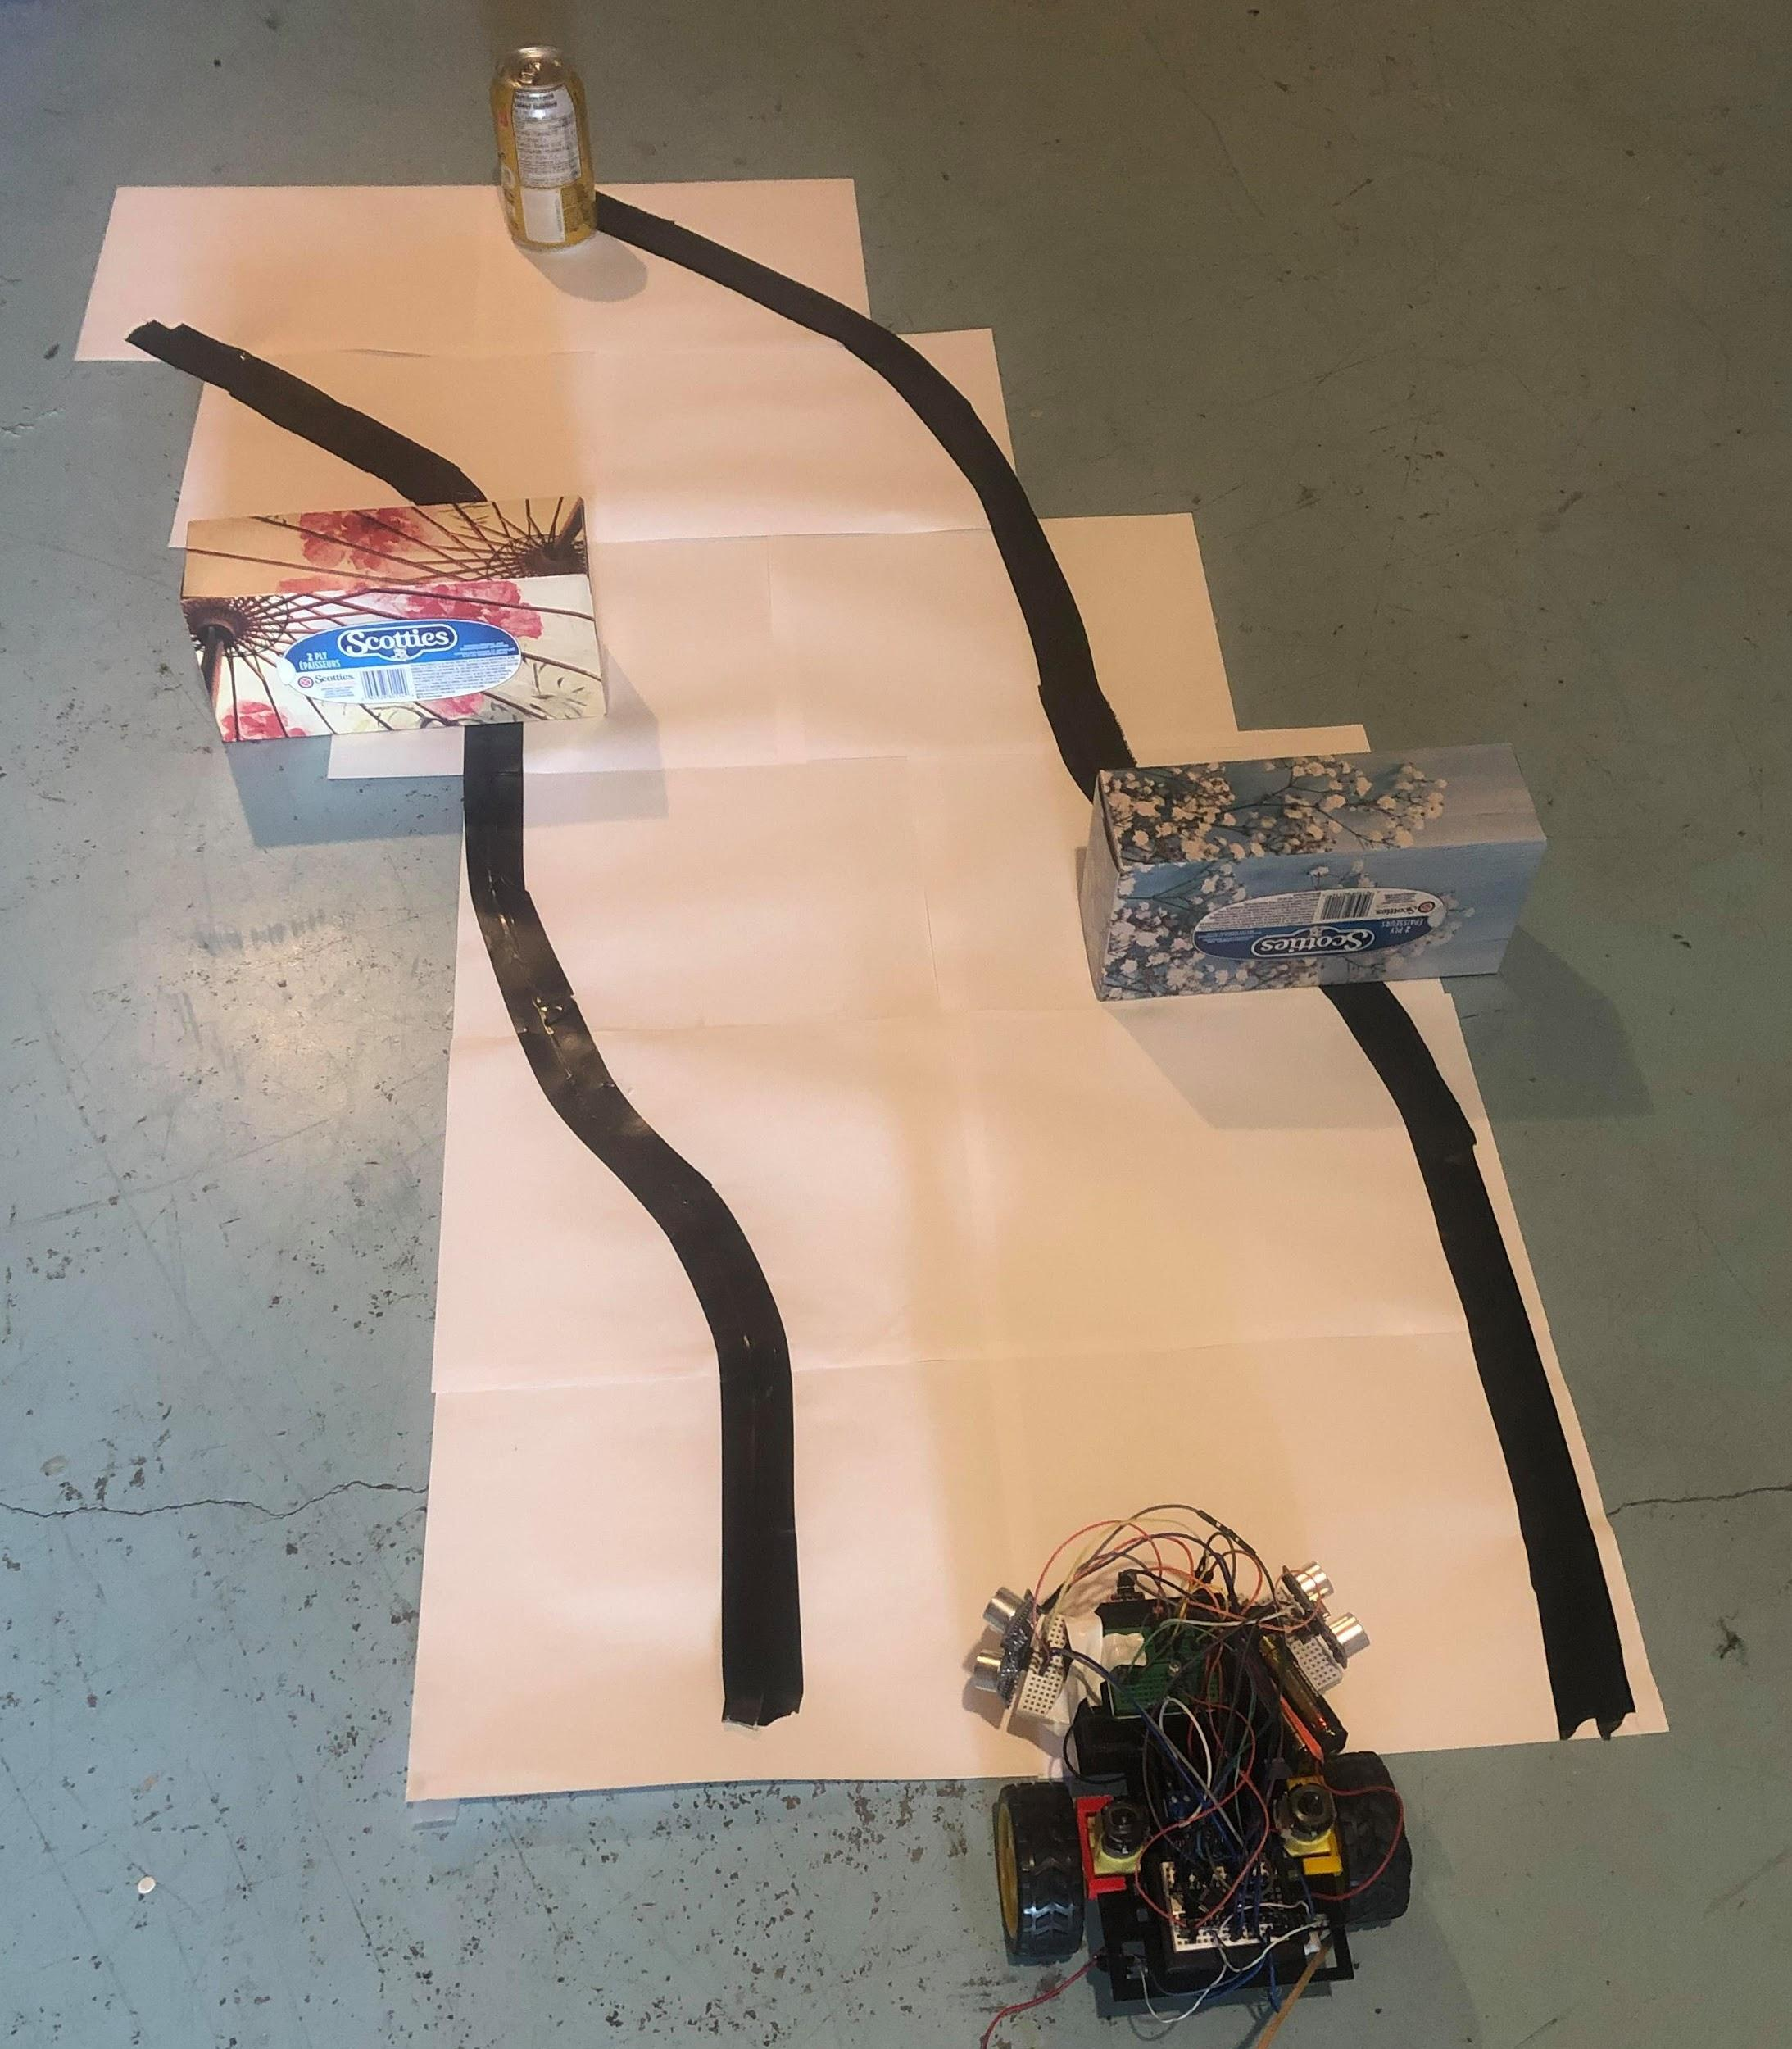
Testing Course
Path outlined by black tape to test IR sensors.
Obstacles along path to test Sonar sensors.
Vehicle controlled by user.
Obstacles and black border must be avoided independent of user input.

Slide 13
ADAS Implementation
Sonar sensors are used to detect if an obstacle is within a threshold distance from vehicle.
Forward sonar sensor will stop the vehicle.
Left and right sonar sensors will make the vehicle automatically deviate from obstacle.
IR sensors are used to keep the vehicle within the black borders.
Left and right sensors will be used to make the vehicle deviate towards the road when crossing the black borders.
Watchdog timer is used to notify user of erroneous system state.
Notes:
Watchdog timer implementation

Slide 14
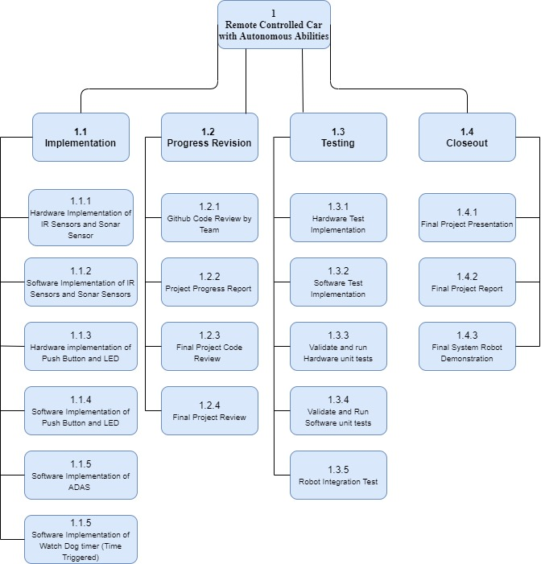
Work Breakdown Structure
Work required for the robot has been classified under 4 criterias;
Implementation - Technical Hardware and Software Tasks
Progress Revision - Documentation and Code Assessment
Testing - Extensive Hardware and Software tests
Closeout - Project Culminating Conclusion
Notes:
Software implementation = drivers implementation

Slide 15
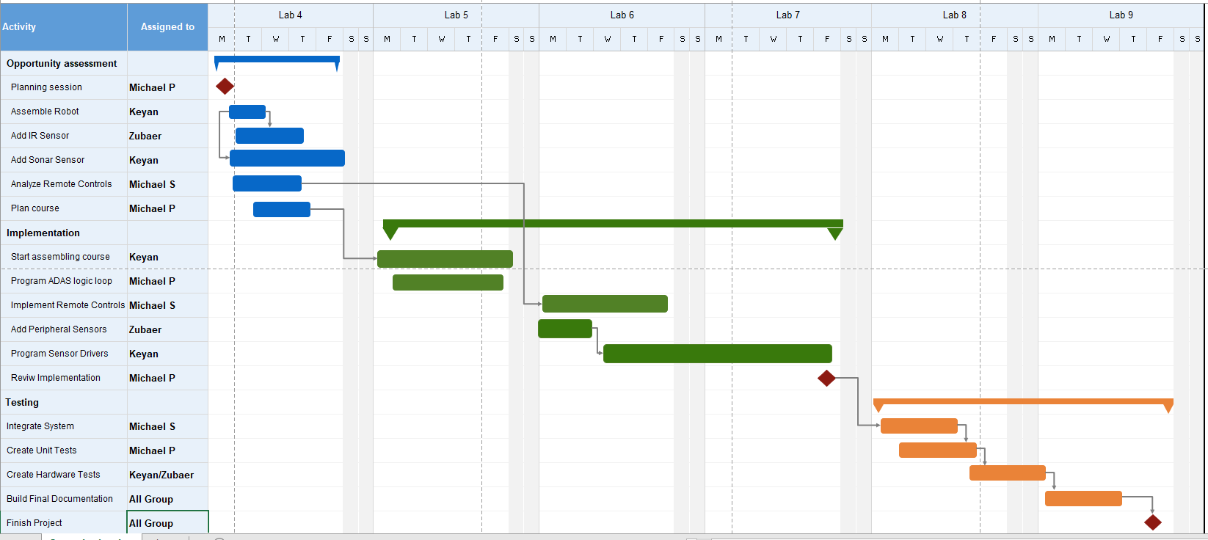
Schedule Workflow
The workflow for the group can be separated into 3 essential areas;
1 - Opportunity Assessment
2 - Implementation
3 - Testing
Notes:
On track for deliverables, hardware requirements has been delivered on time, currently on lab 7 frame, good budget and time

Slide 16
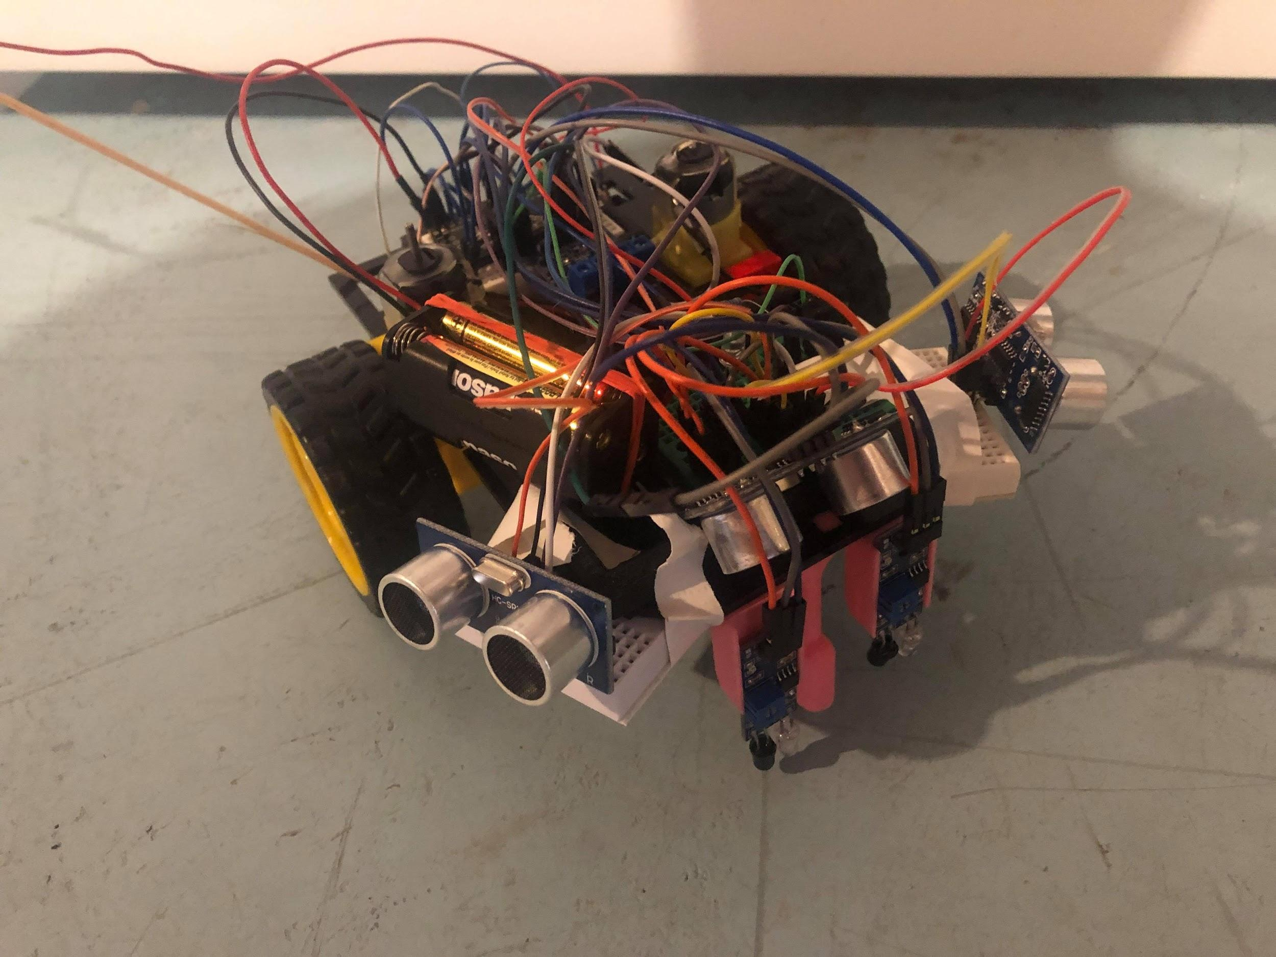
Conclusion
Project will include remote control vehicle with ADAS collision avoidance and boundary detection algorithms.
A test track will be created to test the vehicle ADAS capabilities.
Project is on schedule with expected delivery date of end of term.
Project is low cost as all materials were repurposed from other personal projects.

Slide 17
References
[1] 2020. [image] Available at: <https://threatpost.com/consortium-publishes-manifesto-on-autonomous-vehicle-security/123621/> [Accessed 16 March 2020].
[2] 2020. [Image] Available at: <https://www.intellias.com/how-to-build-adas-software-for-autonomous-driving/> [Accessed 16 March 2020]
[3] 2020. [Image] Available at: <https://www.canalys.com/freereport/latest-free-report?id=11867> [Accessed 16 March 2020]
[4] 2020. [Image] Available at: <https://www.embedded.com/how-smart-sensors-enhance-adas-designs/> [Accessed 16 March 2020]
[5] 2020. [image] Available at: <https://sites.google.com/site/projectsriza/ir-sensor-for-line-and-obstacle-detection> [Accessed 16 March 2020].
[6] 2020. [image] Available at: <https://www.istockphoto.com/ca/vector/echo-is-a-reflection-of-sound-waves-gm503082877-44054052> [Accessed 16 March 2020].

